Slide 1


Mental Health Treatment Prediction
Firdaus Hassan
1

Slide 2
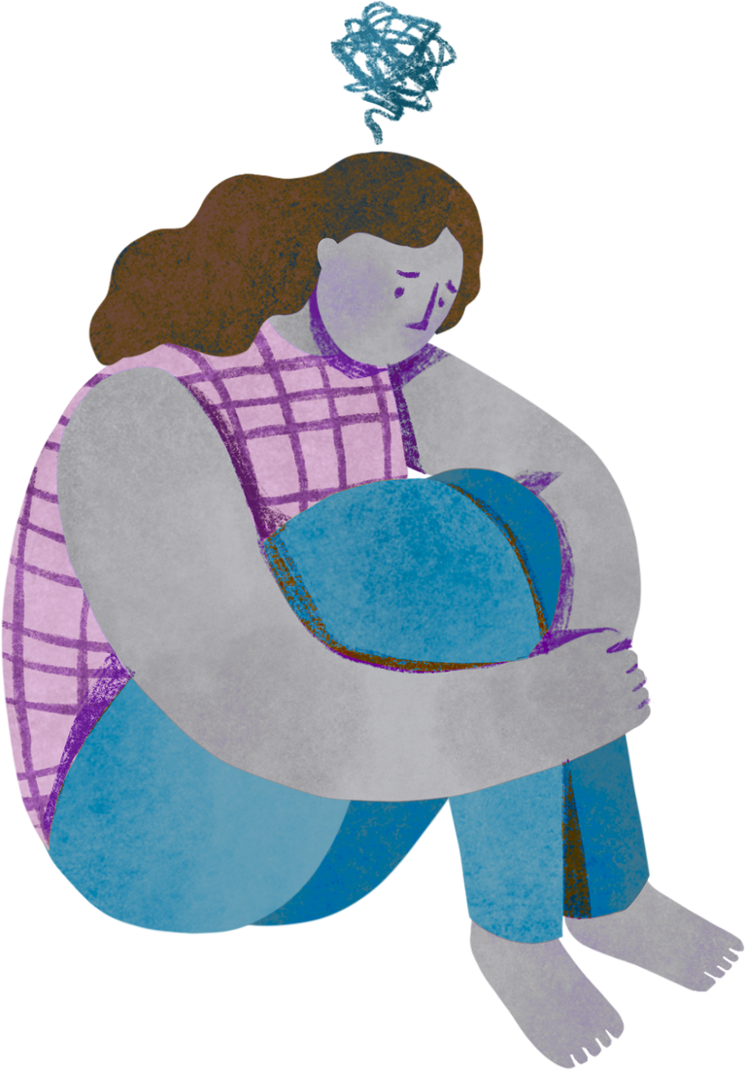
INTRODUCTION
Mental health disorders affect millions worldwide, yet many individuals do not seek professional treatment due to various barriers including stigma, lack of access, and financial constraints. Understanding the factors that influence treatment-seeking behavior is crucial for developing effective interventions and improving mental health outcomes across populations.
Objective of the Analysis:
Identify key predictors of mental health treatment-seeking behavior.
Classify individuals based on their likelihood to seek treatment.
Provide data-driven recommendations for mental health advocacy and resource allocation.
2

Slide 3
Problem Statement
Despite increased awareness of mental health issues, a significant treatment gap persists globally. Current challenges include:
Approximately 50% of individuals with mental health conditions do not seek professional help
Limited resources are often allocated without data-driven prioritization
Stigma and cultural factors create barriers to treatment access
Lack of understanding about which factors most significantly influence help-seeking behavior
By leveraging demographic, behavioral, and psychological data, we can:
Predict individuals' likelihood of seeking mental health treatment
Identify high-risk groups that may need targeted outreach programs
Inform resource allocation for mental health programs and initiatives
Develop targeted destigmatization campaigns based on demographic patterns
3

Slide 4
DATA DESCRIPTON
Data Characteristics Records: 289,000 rows Features: 16 Features including demographic,behavioral and psychological indicators Target Variable: treatment(Binary: Yes/No) Data Source: Mental Health Dataset from kaggle | Dataset Features and their description Timestamp: The time when the data was recorded. Gender: Gender of the individual (e.g. Male, Female). Country: The country in which the individual resides. Occupation: The individual's occupation (e.g., Student, Professional, Business etc). self_employed: Whether the individual is self-employed (Yes/No). family_history: Whether the individual has a family history of mental health issues (Yes/No). Treatment: Whether the individual has received treatment for mental health issues (Yes/No). Social_Weakness: Whether the individual experiences challenges in social interactions (e.g., Yes/No).
Key Features Categories Demographic Attributes: Gender, Occupation, Country, Family History Behavioral Indicators: Days Indoors, Changes in Habits, Coping Struggles Psychological Factors: Growing Stress, Mood Swings, Social Weakness, Work Interest Treatment-Related Variables: Care Options, Mental Health Interview History | Days_Indoors: The number of days the individual spends indoors, potentially correlating with isolation or social withdrawal. Growing_Stress: Indicator of increasing stress levels (e.g., Low, Medium, High). Changes_Habits: Whether there have been noticeable changes in the individual's daily habits (e.g., Yes/No). Mental_Health_History: Historical mental health data, indicating whether the individual has had previous mental health challenges (Yes/No). mental_health_interview: Whether the individual has participated in a mental health interview (Yes/No).
4

Slide 5


Data Preprocessing
Data Cleaning :
Handling Missing Values: Removed records with null values
Duplicate Removal: Eliminated duplicate entries using hashing techniques
Irrelevant Feature Removal: Dropped Timestamp column and low-variance features identified through chi-square tests such as social weakness,change habits
Feature Engineering:
Country Grouping: Consolidated countries with fewer than 20 responses into "Other" category
Created Country_Grouped feature with 12 categories
Text Profile Generation: Created comprehensive text descriptions based on psychological and behavioral features
Sentiment Analysis:
Generated compound sentiment scores from text profiles
Categorized into Positive, Negative, and Neutral sentiment labels
5

Slide 6
Encoding Strategies:
Label Encoding: Applied to binary features (Gender, Family History, Mental_Health_History, Coping_Struggles)
One-Hot Encoding: Used for nominal features (Occupation, Country_Grouped)
Ordinal Encoding: Implemented for ordered categories with logical progression:
Days_Indoors: ['Go Out Every Day' < '1-14 Days' < '15-30 Days' < '31-60 Days' < 'More Than 2 Months']
Mood_Swings: ['Low' < 'Medium' < 'High']
Care_Options: ['No' < 'Not Sure' < 'Yes']
Mental_Health_Interview: ['No' < 'Maybe' < 'Yes']
Growing_Stress: ['No' < 'Maybe' < 'Yes']
Scaling:
Applied StandardScaler to normalize all numerical features
6

Slide 7

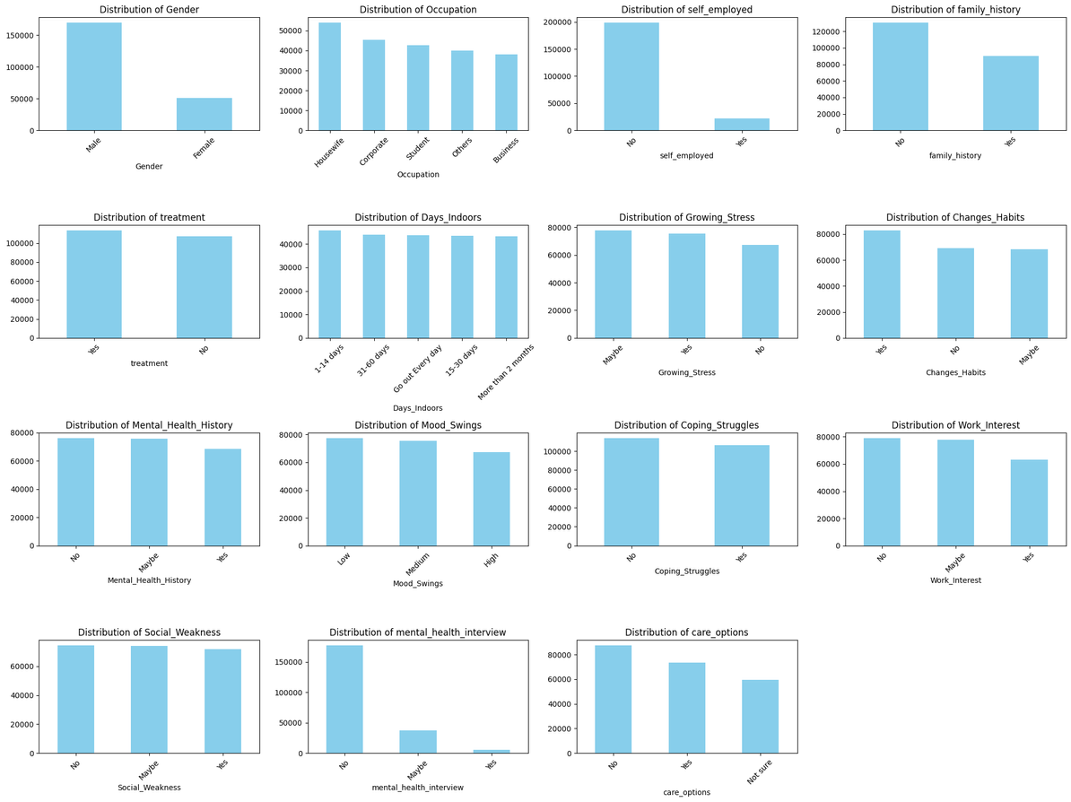
EXPLORATORY DATA ANALYSIS
The dataset shows clear skews across several categorical features.
Gender is heavily male-dominated, while occupation is more balanced across students, corporate employees, business, housewives, and others.
Most respondents are not self-employed and do not report a family history of mental illness.
Behavioral features show that staying indoors is common across different durations, though going out daily is less frequent.
Stress, habit changes, and mental health history are often reported as “No” or “Maybe,” with fewer “Yes” responses.
Mood swings are most commonly medium, followed by low and high. Coping struggles are less frequent, with more respondents reporting no struggles.
7

Slide 8
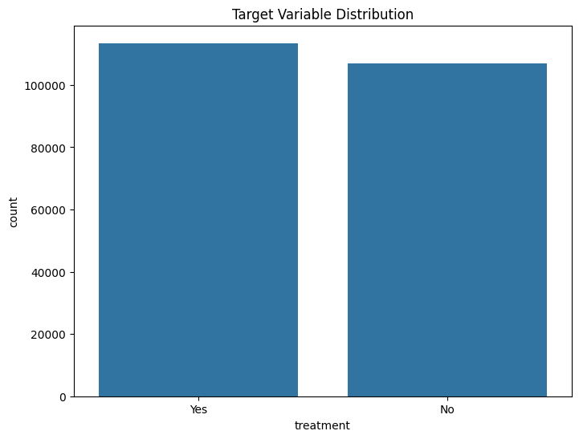
EXPLORATORY DATA ANALYSIS
Target Variable Distribution
The treatment variable shows an ideal balanced distribution with 52% 'Yes' (sought treatment) and 48% 'No' Treatment.
This near-perfect 50-50 split eliminates class imbalance issues and ensures reliable model training.
8

Slide 9
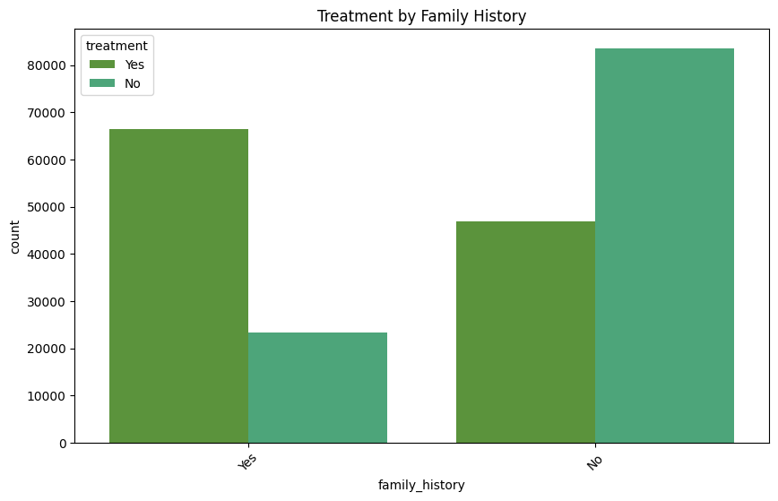
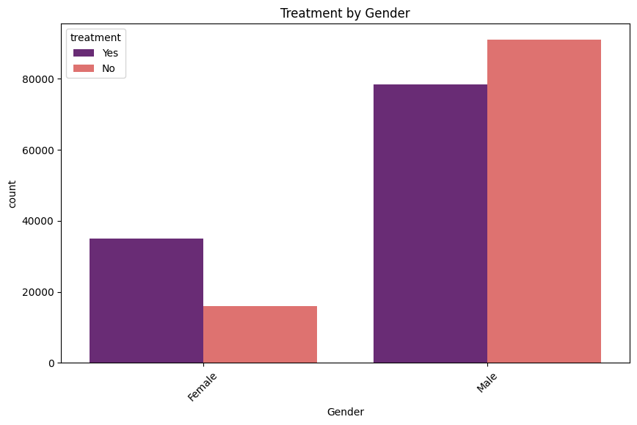
EXPLORATORY DATA ANALYSIS
Respondents with a family history of mental illness are much more likely to seek treatment than those without. The majority of those without family history did not seek treatment.
There is a gender difference in mental health treatment-seeking behavior, with females more likely to seek treatment than males.
9

Slide 10
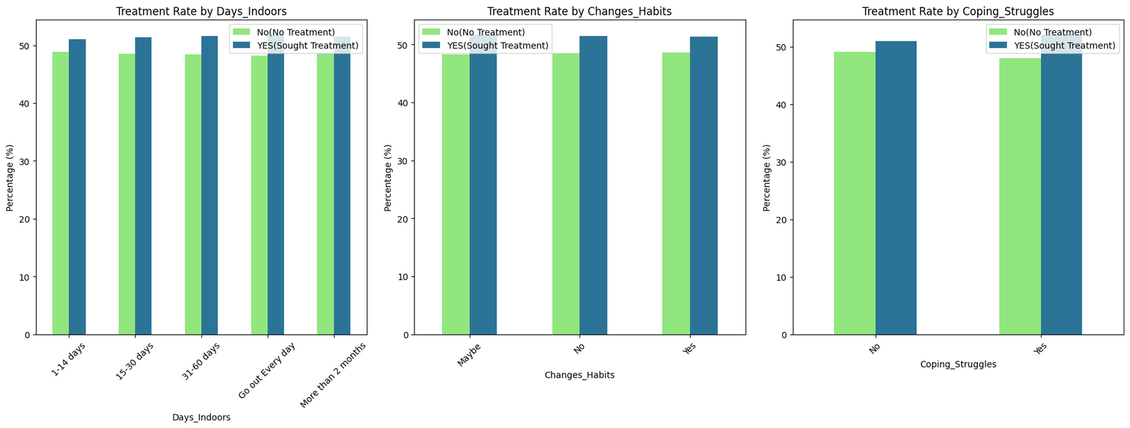
EXPLORATORY DATA ANALYSIS
Behavioral features and treatment
The percentage of people seeking treatment is similar across all categories of time spent indoors, suggesting that staying indoors does not strongly influence treatment-seeking behavior.
Changes in Habits:Whether respondents reported changes in habits or not, the treatment-seeking rate remains nearly the same, indicating little impact.
Coping Struggles:Both groups (those who struggle and those who do not) have similar rates of seeking treatment, showing coping struggles alone do not drive treatment decisions.
10

Slide 11
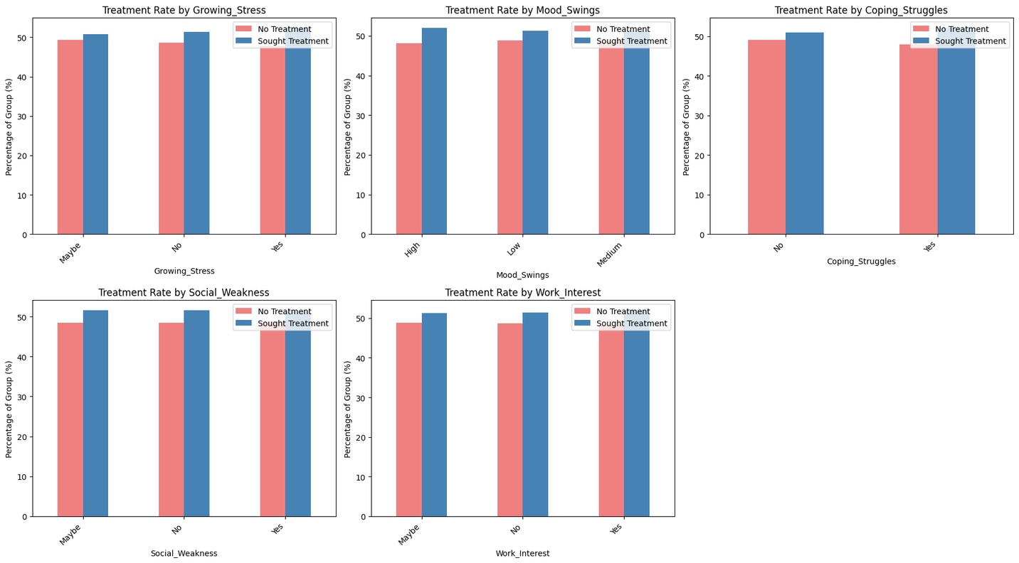
EXPLORATORY DATA ANALYSIS
Psychological Features and treatment
Growing Stress, Mood Swings, Coping Struggles, Social Weakness, Work Interest:
For all psychological factors, the percentage of people seeking treatment is almost equal to those not seeking treatment within each group.
This suggests these individual psychological factors do not have a strong direct influence on treatment-seeking behavior in this dataset.
11

Slide 12
EXPLORATORY DATA ANALYSIS
Psychological Features and treatment
Growing Stress, Mood Swings, Coping Struggles, Social Weakness, Work Interest:
For all psychological factors, the percentage of people seeking treatment is almost equal to those not seeking treatment within each group.
This suggests these individual psychological factors do not have a strong direct influence on treatment-seeking behavior in this dataset.
12

Slide 13


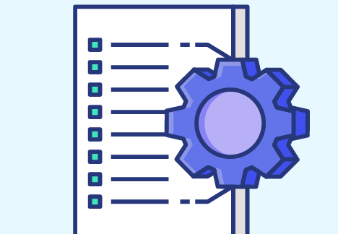

Methodology
Approach
Step 2
Feature Engineering and
encoding
Step 4
Step 3
Training/validating
models
Model performance comparison and interpretation
Step 1
Data Cleaning and
preprocessing
13

Slide 14


MODELLING APPROACH
Algorithm Selection
Four classification algorithms were evaluated:
Multi-Layer Perceptron (MLP) - Neural network approach
Logistic Regression - Baseline linear model
Random Forest - Ensemble tree method
Gradient Boosting - Sequential ensemble technique
Training Protocol
Train-Test Split: 80-20 stratified split preserving class distribution
Cross-Validation: 5-fold stratified cross-validation
Hyperparameter Tuning: RandomizedSearchCV for Random Forest
Evaluation Metrics: Accuracy, Precision, Recall, F1-Score, AUC-ROC
14

Slide 15
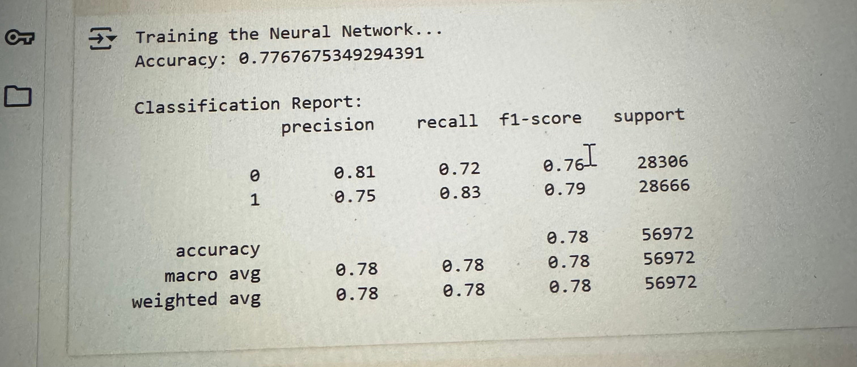
MODELLING APPROACH
Performance Results
The MLP Neural Network achieved the highest accuracy at 78%, making it the best performer due to its ability to capture complex non-linear relationships in mental health data.
Gradient Boosting ranked second with 75% accuracy, demonstrating strong ensemble learning capabilities and balanced precision-recall metrics across both classes.
Random Forest came third at 74% accuracy, providing solid baseline performance with good stability through its ensemble of decision trees.
Logistic Regression ranked last with 72% accuracy, limited by its linear assumptions which fail to capture the intricate patterns inherent in mental health treatment-seeking behavior, though it remains valuable for interpretability.
Retry
15

Slide 16
Hyperparameter Optimization
To maximize the predictive power of our Random Forest model, we employed a rigorous hyperparameter tuning strategy. This process was designed to find the perfect balance between model complexity and computational efficiency, ensuring robust performance without overfitting.
Algorithm: We utilized RandomizedSearchCV for its superior efficiency in exploring a wide hyperparameter space without the prohibitive cost of an exhaustive grid search.
Best Parameters: n_estimators=200, max_depth=30, min_samples_split=5, min_samples_leaf=2, max_features='sqrt'
Improvement: +3% accuracy over default parameters
16

Slide 17
SENTIMENT ANALYSIS
Methodology
Generated textual profiles combining psychological and behavioral features
Sentiment Compound: We applied VADER (Valence Aware Dictionary and sEntiment Reasoner), a lexicon and rule-based model specifically attuned to sentiments in social media/text, to analyze these profiles.
Categorization: Each profile received a compound sentiment score from -1 (most negative) to +1 (most positive). We categorized these scores as follows:
Negative: < -0.05
Neutral: -0.05 to 0.05
Positive: > 0.05
Results: A Clear Negative Bias - contrary to a typical distribution,our analysis revealed an overwhelminglt negative landscape.
17

Slide 18
RESULTS & INSIGHTS
Family History
Respondents with a family history of mental illness are significantly more likely to seek treatment. This suggests that personal awareness, exposure, or empathy may encourage proactive behavior toward mental health care.
Care Options
Awareness of care options strongly influences whether someone pursues treatment. When people know about support services, they are far more likely to seek help. Conversely, lack of awareness or uncertainty (“Not sure”) is a barrier to treatment, showing that accessibility and communication are critical.
Gender
While the dataset is male-dominated, analysis shows that females are slightly more open to seeking treatment compared to males. This reflects possible cultural or social differences in willingness to acknowledge mental health issues and pursue care.
Mental Health Interview
Most respondents have never experienced a mental health interview, but those who have are more likely to seek treatment. This highlights the positive role of workplace or institutional discussions in normalizing mental health and guiding individuals toward help.
18

Slide 19
RECOMMENDATIONS
Increase Awareness of Care Options
Many respondents were unaware of available support. Organizations and institutions should actively promote mental health services, resources, and counseling options to reduce barriers to seeking treatment.
2. Encourage Workplace Conversations
Mental health interviews or discussions can positively influence treatment-seeking. Employers can normalize these conversations through wellness check-ins, HR policies, and confidential counseling support.
3. Targeted Support for High-Risk Groups
Individuals with a family history of mental illness should be prioritized for early interventions, screenings, or awareness programs since they are more likely to face challenges.
4.Address Gender Disparities
Since males are less likely to seek treatment, campaigns and initiatives should specifically target reducing stigma among men and encouraging openness toward mental health care.
5. Engagement with the Mental Health Community:
Foster collaboration between researchers, mental health professionals, and data scientists.
Share insights with NGOs and advocacy groups working on mental health awareness.
Engage with workplaces and educational institutions to apply findings in real-world contexts.
Encourage open dialogue and knowledge exchange to continuously improve mental health solutions.
19

Slide 20

THANK YOU
Try the live app here !
Streamlit App Link
20

